Slide 1
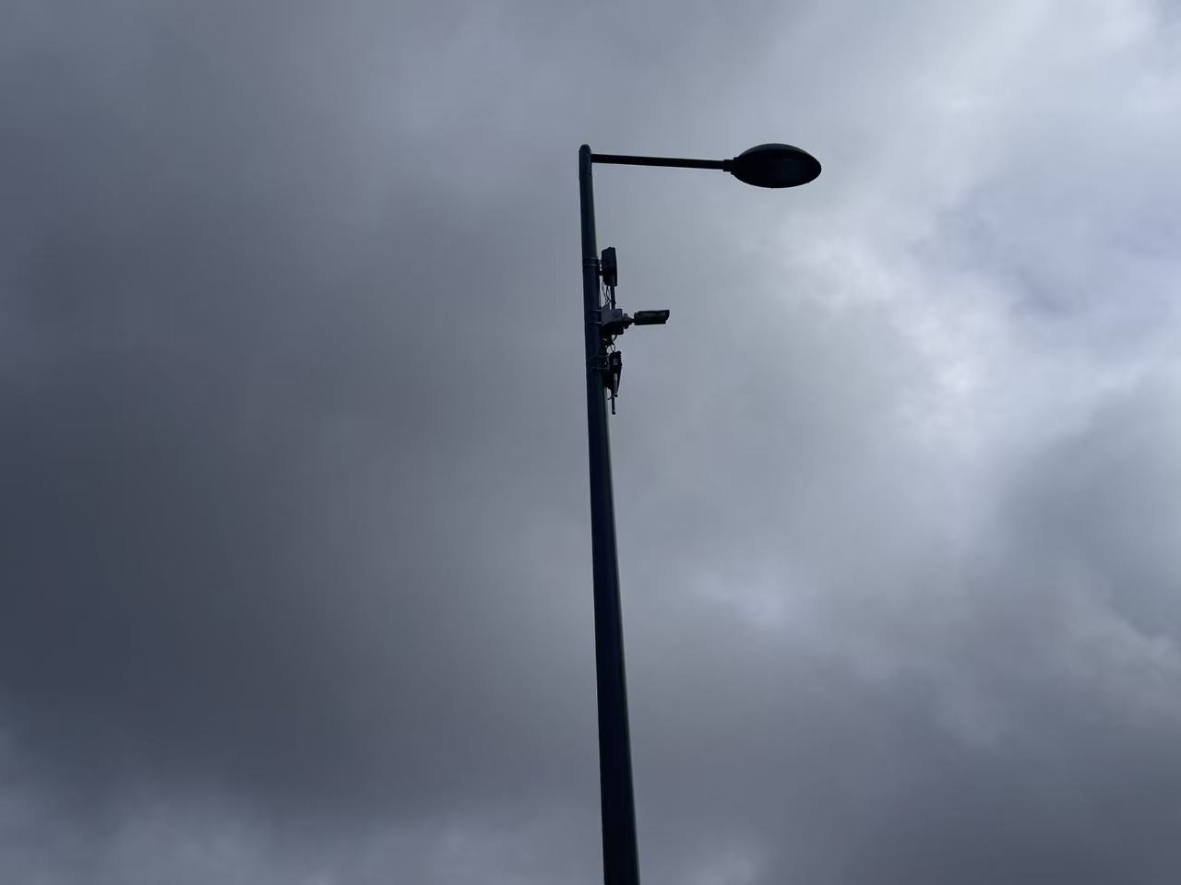
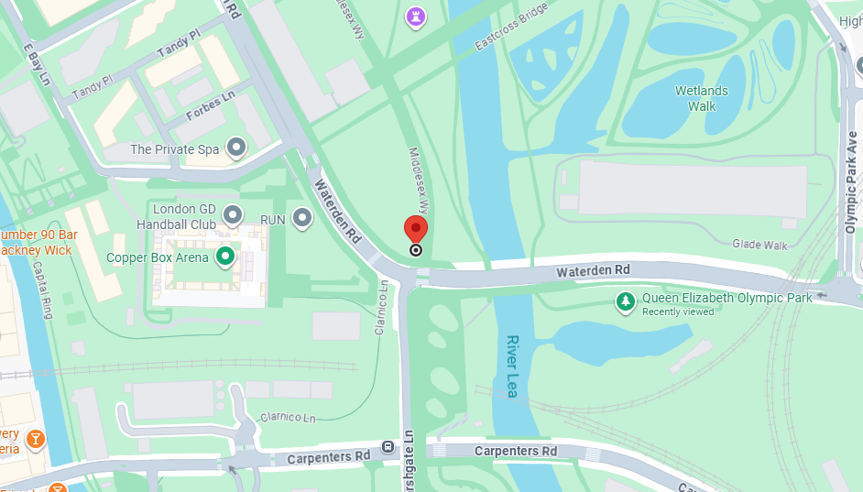
Cars in street monitoring.
This sensor may be used to measure how many vehicles pass through a specific section of the road within a certain period of time.
Questions when visiting site?
How many vehicles passed during the time period when I went through this road.
How often do they need maintenance, and how can rainwater erosion be prevented?
Location info:
@51.544418, -0.017674
Middlesex Wy., London E20 3AZ
https://maps.app.goo.gl/hh5GoTQhvDLBzFzV6
what3words: ///brands.live.calculating
Submitted: Xinyuan Sun 2025
Notes:
A title and a couple of sentences describing the technology and possibly linking to further information online.
A photo of the technology in situ with a corresponding map showing where it is.
2 or 3 questions that you might ask when you are in situ at the site of the technology to engage others in a discussion about that technology
The following geographic data:
Lat Long
Street Address
Google maps link
What3words location
Also add in the names of those submitting this data.

